Slide 1
Relations
Relations and their Properties
Representing Relations
Closures of Relations
Equivalence Relations
Partial Orderings
Discrete Mathematics : Relations

Slide 2
Today’s menu
Binary relation
N-ary relation
Properties
Representation
Discrete Mathematics : Relations

Slide 3
Relations
If we want to describe a relationship between elements of two sets A and B, we can use ordered pairs with their first element taken from A and their second element taken from B.
Since this is a relation between two sets, it is called a binary relation.
Definition: Let A and B be sets. A binary relation from A to B is a subset of A×B.
In other words, for a binary relation R we have
R ⊆ A×B. We use the notation aRb to denote that (a, b)∈R and aRb to denote that (a, b)∉R.
Discrete Mathematics : Relations

Slide 4
Relations
When (a, b) belongs to R, a is said to be related to b by R.
Example: Let P be a set of people, C be a set of cars, and D be the relation describing which person drives which car(s).
P = {Carl, Suzanne, Peter, Carla},
C = {Mercedes, BMW, tricycle}
D = {(Carl, Mercedes), (Suzanne, Mercedes),
(Suzanne, BMW), (Peter, tricycle)}
This means that Carl drives a Mercedes, Suzanne drives a Mercedes and a BMW, Peter drives a tricycle, and Carla does not drive any of these vehicles.
Discrete Mathematics : Relations

Slide 5




Definition A binary relation R from a set A to a set B is a subset of AB.
  Note:
  A binary relation R is a set.
  R  AB
Example
(1) Let A and B be sets,
(2)
(3) Let R be the set of real numbers,
Discrete Mathematics : Relations

Slide 6
Relations on a Set
Definition: A relation on the set A is a relation from A to A.
In other words, a relation on the set A is a subset of A×A.
Example: Let A = {1, 2, 3, 4}. Which ordered pairs are in the relation R = {(a, b) | a < b} ?
Discrete Mathematics : Relations

Slide 7
Relations on a Set
Example：consider the following relations on the set of the integers:
R₁= {（x,y） |x,yZ  xy }
R₂= {（x,y） |x,yZ x>y}
R₃= {（x,y） |x,yZ x=y or x=-y}
R₄= {（x,y） |x,yZ x=y}
R₅= {（x,y） |x,yZ x=y+1}
R₆= {（x,y） |x,yZ x+y  3}
Which of these relations contain each of the pairs
(1,1),(1,2),(2,1),(1,-1),(2,2)?
Discrete Mathematics : Relations

Slide 8
Relations on a Set
How many different relations can we define on a set A with n elements?
A relation on a set A is a subset of A×A.
How many elements are in A×A ?
There are n² elements in A×A, so how many subsets (= relations on A) does A×A have?
The number of subsets that we can form out of a set with m elements is 2^{m}. Therefore, 2^{n2} subsets can be formed out of A×A.
Answer: We can define 2^{n2} different relations
on A.
Discrete Mathematics : Relations

Slide 9
n-ary Relations
Definition: Let A₁, A₂, …, A_{n} be sets. An n-ary relation on these sets is a subset of A₁×A₂×…×A_{n}.
The sets A₁, A₂, …, A_{n} are called the domains of the relation, and n is called its degree.
Discrete Mathematics : Relations

Slide 10
n-ary Relations
Example:
Let R = {(a, b, c) | a = 2b ∧ b = 2c with a, b, c∈Z}
What is the degree of R?
The degree of R is 3, so its elements are triples.
What are its domains?
Its domains are all equal to the set of integers.
Is (2, 4, 8) in R?
No.
Is (4, 2, 1) in R?
Yes.
Discrete Mathematics : Relations

Slide 11
Properties of Relations
We will now look at some useful ways to classify relations.
Definition: A relation R on a set A is called reflexive if (a, a)∈R for every element a∈A.
Are the following relations on {1, 2, 3, 4} reflexive?
R = {(1, 1), (1, 2), (2, 3), (3, 3), (4, 4)}
No.
R = {(1, 1), (2, 2), (2, 3), (3, 3), (4, 4)}
Yes.
R = {(1, 1), (2, 2), (3, 3)}
No.
Definition: A relation on a set A is called irreflexive if (a, a)R for every element aA.
Discrete Mathematics : Relations

Slide 12
Properties of Relations
Definitions:
A relation R on a set A is called symmetric if (b, a)∈R whenever (a, b)∈R for all a, b∈A.
A relation R on a set A is called antisymmetric if
a = b whenever (a, b)∈R and (b, a)∈R.
A relation R on a set A is called asymmetric if
(a, b)∈R implies that (b, a)∉R for all a, b∈A.
Discrete Mathematics : Relations

Slide 13
Properties of Relations
Are the following relations on {1, 2, 3, 4}
symmetric, antisymmetric, or asymmetric?
R = {(1, 1), (1, 2), (2, 1), (3, 3), (4, 4)}
symmetric
R = {(1, 1)}
sym. and antisym.
R = {(1, 3), (3, 2), (2, 1)}
antisym. and asym.
R = {(4, 4), (3, 3), (1, 4)}
antisym.
Discrete Mathematics : Relations

Slide 14
Properties of Relations
Definition: A relation R on a set A is called transitive if whenever (a, b)∈R and (b, c)∈R, then (a, c)∈R for a, b, c∈A.
Are the following relations on {1, 2, 3, 4}
transitive?
R = {(1, 1), (1, 2), (2, 2), (2, 1), (3, 3)}
Yes.
R = {(1, 3), (3, 2), (2, 1)}
No.
R = {(2, 4), (4, 3), (2, 3), (4, 1)}
No.
Discrete Mathematics : Relations

Slide 15
Which of the relations are reflexive,irreflexive, symmetric, antisym., asym and transitive ?
R₁= {（x,y） |x,yZ  xy }
R₂= {（x,y） |x,yZ x>y}
R₃= {（x,y） |x,yZ x=y or x=-y}
R₄= {（x,y） |x,yZ x=y}
R₅= {（x,y） |x,yZ x=y+1}
R₆= {（x,y） |x,yZ x+y  3}
The “Divides” relation on the set of positive integers.
Reflexive, antisymmetric and transitive
Antisymmetric, Asymmetric, irreflexive, transitive
Reflexive, and transitive
Discrete Mathematics : Relations

Slide 16
Counting Relations
Example: How many different reflexive relations can be defined on a set A containing n elements?
Solution: Relations on R are subsets of A×A, which contains n² elements.
Therefore, different relations on A can be generated by choosing different subsets out of these n² elements, so there are 2^{n2} relations.
A reflexive relation, however, must contain the n elements (a, a) for every a∈A.
Consequently, we can only choose among n² – n =
n(n – 1) elements to generate reflexive relations, so there are 2^{n(n – 1)} of them.
Discrete Mathematics : Relations

Slide 17
Counting Relations
Example: How many different symmetric relations can be defined on a set A containing n elements?
Example: How many different antisymmetric relations can be defined on a set A containing n elements?
Example: How many different asymmetric relations can be defined on a set A containing n elements?
Discrete Mathematics : Relations

Slide 18
How many different symmetric relations can be defined on a set A containing n elements?
A relation R is symmetric if the value of every cell (i, j) is same as that cell (j, i). The diagonals can have any value.
There are n diagonal values, total possible combination of diagonal values = 2^{n}
There are n² – n non-diagonal values. We can only choose different value for half of them, because when we choose a value for cell (i, j), cell (j, i) gets same value.
So combination of non-diagonal values = 2^{(n2 – n)/2}
Overall combination = 2^{n} * 2^{(n2 – n)/2} = 2^{n(n+1)/2}
Discrete Mathematics : Relations

Slide 19
Combining Relations
Relations are sets, and therefore, we can apply the usual set operations to them.
If we have two relations R₁ and R₂, and both of them are from a set A to a set B, then we can combine them to R₁ ∪ R₂, R₁ ∩ R₂, or R₁ – R₂.
In each case, the result will be another relation from A to B.
Discrete Mathematics : Relations

Slide 20
Combining Relations
… and there is another important way to combine relations.
Definition: Let R be a relation from a set A to a set B and S a relation from B to a set C. The composite of R and S is the relation consisting of ordered pairs (a, c), where a∈A, c∈C, and for which there exists an element b∈B such that (a, b)∈R and (b, c)∈S. We denote the composite of R and S by S°R.
In other words, if relation R contains a pair (a, b) and relation S contains a pair (b, c), then S°R contains a pair (a, c).
Discrete Mathematics : Relations

Slide 21
Combining Relations
Example: Let D and S be relations on A = {1, 2, 3, 4}.
D = {(a, b) | b = 5 - a} “b equals (5 – a)”
S = {(a, b) | a < b} “a is smaller than b”
D = {(1, 4), (2, 3), (3, 2), (4, 1)}
S = {(1, 2), (1, 3), (1, 4), (2, 3), (2, 4), (3, 4)}
S°D = {
(2, 4),
(3, 3),
(3, 4),
(4, 2),
(4, 3),
(4, 4)}
D maps an element a to the element (5 – a), and afterwards S maps (5 – a) to all elements larger than (5 – a), resulting in SD = {(a,b) | b > 5 – a} or SD = {(a,b) | a + b > 5}.
Discrete Mathematics : Relations

Slide 22
Combining Relations
Definition: Let R be a relation on the set A. The powers R^{n}, n = 1, 2, 3, …, are defined inductively by
R¹ = R
R^{n+1} = R^{n}°R
In other words:
R^{n} = R°R° … °R (n times the letter R)
What is R⁰ ?
Discrete Mathematics : Relations

Slide 23
Combining Relations
Example: Let R={(1,1),(2,1),(3,2),(4,3)} be a relation on the set A. Find the powers R^{n}, n = 1, 2, 3, …,
Solution
R¹ = R
R^{n+1} = R^{n}°R
R² = R°R= {(1,1),(2,1),(3,1),(4,2)}
R³ = R²°R ={(1,1),(2,1),(3,1),(4,1)}
R⁴ = R³
Discrete Mathematics : Relations

Slide 24
Combining Relations
Theorem: The relation R on a set A is transitive if and only if R^{n} ⊆ R for all positive integers n.
Remember the definition of transitivity:
Definition: A relation R on a set A is called transitive if whenever (a, b)∈R and (b, c)∈R, then (a, c)∈R for a, b, c∈A.
The composite of R with itself contains exactly these pairs (a, c).
Therefore, for a transitive relation R, R°R does not contain any pairs that are not in R, so R°R ⊆ R.
Since R°R does not introduce any pairs that are not already in R, it must also be true that (R°R)°R ⊆ R, and so on, so that R^{n} ⊆ R.
Discrete Mathematics : Relations

Slide 25
Combining Relations
Another Example: Let X and Y be relations on
A = {1, 2, 3, …}.
X = {(a, b) | b = a + 1} “b equals a plus 1”
Y = {(a, b) | b = 3a} “b equals 3 times a”
X = {(1, 2), (2, 3), (3, 4), (4, 5), …}
Y = {(1, 3), (2, 6), (3, 9), (4, 12), …}
X°Y = {
(1, 4),
(2, 7),
(3, 10),
(4, 13),
…}
Y maps an element a to the element 3a, and afterwards X maps 3a to 3a + 1.
XY = {(a,b) | b = 3a + 1}
Discrete Mathematics : Relations

Slide 26
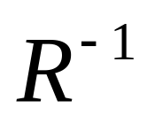
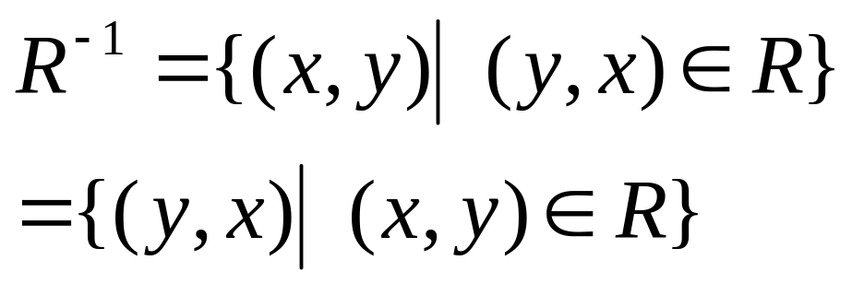
Inverse Relation
How to define
?
Discrete Mathematics : Relations

Slide 27
Representing Relations
The methods of representing relation:
    list its all ordered pairs
    using a set build notation/specification by predicates
    2D table
    Connection matrix /zero-one matrix
    Directed graph/Digraph
Discrete Mathematics : Relations

Slide 28

 | 2 | 3 | 4 | 5 | 6
2 |  |  |  |  | 
3 |  |  |  |  | 
4 |  |  | 
Discrete Mathematics : Relations

Slide 29
Representing Relations
Solution: R = {
(1, 2),
(1, 3),
(1, 4),
(2, 3),
(2, 4),
(3, 4)}
1
1
R | 1 | 2 | 3 | 4
1
2
3
4
X
X
X
2
2
X
X
3
3
X
4
4
Discrete Mathematics : Relations

Slide 30
Representing Relations
We already know different ways of representing relations. We will now take a closer look at two ways of representation: Zero-one matrices and directed graphs.
If R is a relation from A = {a₁, a₂, …, a_{m}} to B =
{b₁, b₂, …, b_{n}}, then R can be represented by the zero-one matrix M_{R} = [m_{ij}] with
m_{ij} = 1, if (a_{i}, b_{j})∈R, and
m_{ij} = 0, if (a_{i}, b_{j})∉R.
Note that for creating this matrix we first need to list the elements in A and B in a particular, but arbitrary order.
Discrete Mathematics : Relations

Slide 31
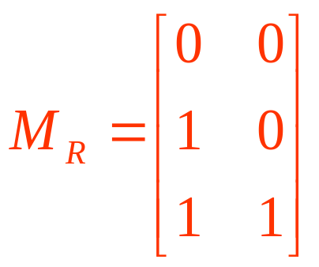
Representing Relations
Example: How can we represent the relation
R = {(2, 1), (3, 1), (3, 2)} A={1,2,3},B-{1,2}as a zero-one matrix?
Solution: The matrix M_{R} is given by
Discrete Mathematics : Relations

Slide 32
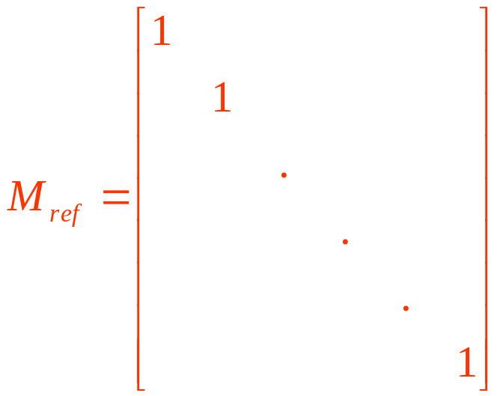
Representing Relations
What do we know about the matrices representing a relation on a set (a relation from A to A) ?
They are square matrices.
What do we know about matrices representing reflexive relations?
All the elements on the diagonal of such matrices M_{ref} must be 1s.
Discrete Mathematics : Relations

Slide 33
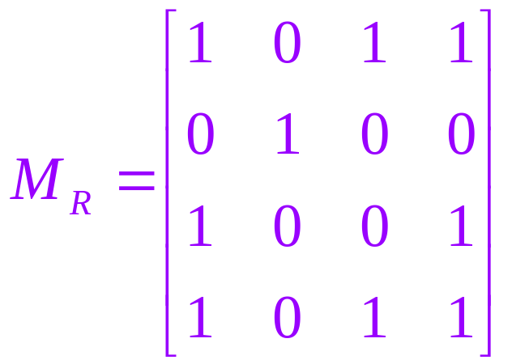
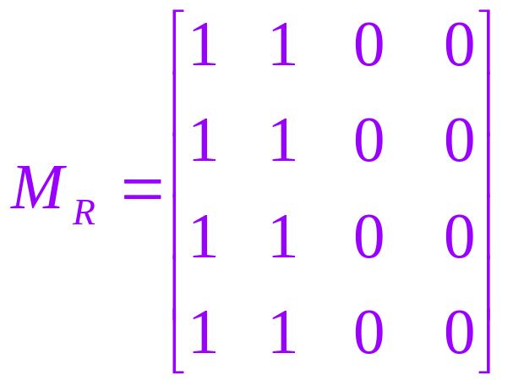
Representing Relations
What do we know about the matrices representing symmetric relations?
These matrices are symmetric, that is, M_{R} = (M_{R})^{t}.
symmetric matrix,
symmetric relation.
non-symmetric matrix,
non-symmetric relation.
Discrete Mathematics : Relations

Slide 34
Representing Relations
The Boolean operations join and meet can be used to determine the matrices representing the union and the intersection of two relations, respectively.
To obtain the join of two zero-one matrices, we apply the Boolean “or” function to all corresponding elements in the matrices.
To obtain the meet of two zero-one matrices, we apply the Boolean “and” function to all corresponding elements in the matrices.
Discrete Mathematics : Relations

Slide 35
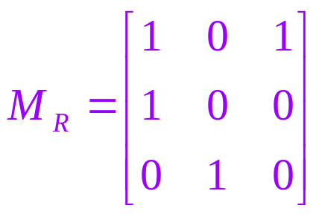
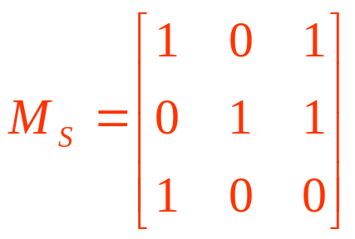
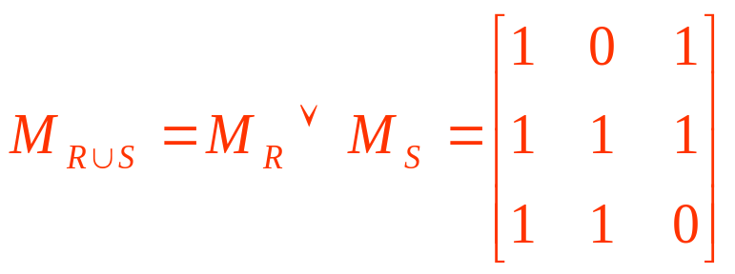
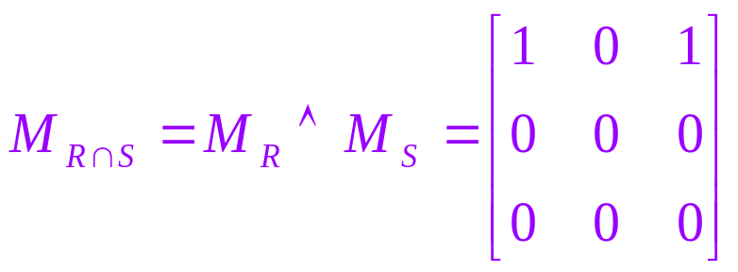
Representing Relations
Example: Let the relations R and S be represented by the matrices
What are the matrices representing RS and RS?
Solution: These matrices are given by
Discrete Mathematics : Relations

Slide 36
Representing Relations Using Matrices
Let A = [a_{ij}] be an mk zero-one matrix and
B = [b_{ij}] be a kn zero-one matrix.
Then the Boolean product of A and B, denoted by A□B, is the mn matrix with (i, j)th entry [c_{ij}], where
c_{ij} = (a_{i1}  b_{1j})  (a_{i2}  b_{2i})  …  (a_{ik}  b_{kj}).
c_{ij} = 1 if and only if at least one of the terms
(a_{in}  b_{nj}) = 1 for some n; otherwise c_{ij} = 0.
Discrete Mathematics : Relations

Slide 37
Representing Relations Using Matrices
Let us now assume that the zero-one matrices
M_{A} = [a_{ij}], M_{B} = [b_{ij}] and M_{C} = [c_{ij}] represent relations A, B, and C, respectively.
Remember: For M_{C} = M_{A}□M_{B} we have:
c_{ij} = 1 if and only if at least one of the terms
(a_{in}  b_{nj}) = 1 for some n; otherwise c_{ij} = 0.
In terms of the relations, this means that C contains a pair (x_{i}, z_{j}) if and only if there is an element y_{n} such that (x_{i}, y_{n}) is in relation A and
(y_{n}, z_{j}) is in relation B.
Therefore, C = BA (composite of A and B).
Discrete Mathematics : Relations

Slide 38
Representing Relations Using Matrices
This gives us the following rule:
M_{BA} = M_{A}□M_{B}
In other words, the matrix representing the composite of relations A and B is the Boolean product of the matrices representing A and B.
Analogously, we can find matrices representing the powers of relations:
M_{R}n = M_{R}^{[n]} (n-th Boolean power).
Discrete Mathematics : Relations

Slide 39
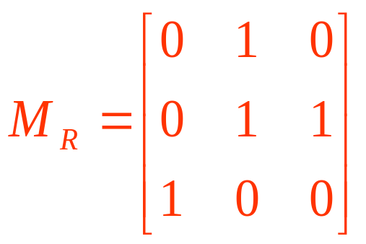
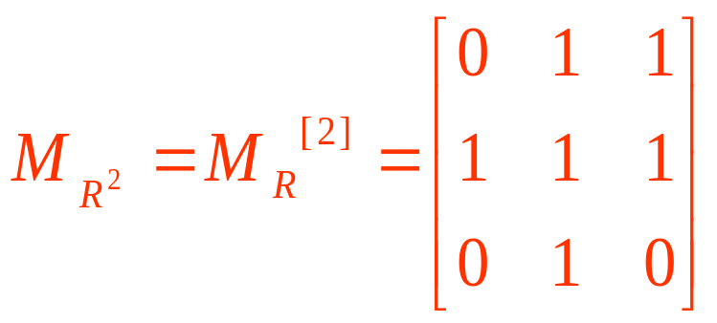
Representing Relations Using Matrices
Example: Find the matrix representing R², where the matrix representing R is given by
Solution: The matrix for R² is given by
Discrete Mathematics : Relations

Slide 40
Representing Relations Using Digraphs
Definition: A directed graph, or digraph, consists of a set V of vertices (or nodes) together with a set E of ordered pairs of elements of V called edges (or arcs).
The vertex a is called the initial vertex of the edge (a, b), and the vertex b is called the terminal vertex of this edge.
We can use arrows to display graphs.
Discrete Mathematics : Relations

Slide 41
Representing Relations Using Digraphs
Example: Display the digraph with V = {a, b, c, d},
E = {(a, b), (a, d), (b, b), (b, d), (c, a), (c, b), (d, b)}.
a
b
d
c
An edge of the form (b, b) is called a loop.
Discrete Mathematics : Relations

Slide 42
Representing Relations Using Digraphs
Obviously, we can represent any relation R on a set A by the digraph with A as its vertices and all pairs (a, b)∈R as its edges.
Vice versa, any digraph with vertices V and edges E can be represented by a relation on V containing all the pairs in E.
This one-to-one correspondence between relations and digraphs means that any statement about relations also applies to digraphs, and vice versa.
Discrete Mathematics : Relations

Slide 43
Today’s menu
Closure of Relation
Discrete Mathematics : Relations

Slide 44
Closures of Relations
What is the closure of a relation?
Definition: Let R be a relation on a set A. R may or may not have some property P, such as reflexivity, symmetry, or transitivity.
If there is a relation S with property P containing R such that S is a subset of every relation with property P containing R, then S is called the closure of R with respect to P.
Note that the closure of a relation with respect to a property may not exist.
Discrete Mathematics : Relations

Slide 45

Closure of Relation
R is binary relation on set A
Then
The reflexive closure of R is
R ∪ Δ = R ∪ {(a,a)|a ∈ A}
The symmetric closure of R is
Discrete Mathematics : Relations

Slide 46
Closures of Relations
Example I: Find the reflexive closure of relation R = {(1, 1), (1, 2), (2, 1), (3, 2)} on the set A = {1, 2, 3}.
Solution: We know that any reflexive relation on A must contain the elements (1, 1), (2, 2), and (3, 3).
By adding (2, 2) and (3, 3) to R, we obtain the reflexive relation S, which is given by
S = {(1, 1), (1, 2), (2, 1), (2, 2), (3, 2), (3, 3)}.
S is reflexive, contains R, and is contained within every reflexive relation that contains R.
Therefore, S is the reflexive closure of R.
Discrete Mathematics : Relations

Slide 47
Closures of Relations
Example II: Find the symmetric closure of the relation R = {(a, b) | a > b} on the set of positive integers.
Solution: The symmetric closure of R is given by
R∪R⁻¹ = {(a, b) | a > b} ∪ {(b, a) | a > b}
= {(a, b) | a ≠ b}
Discrete Mathematics : Relations

Slide 48
Closures of Relations
Example III: Find the transitive closure of the relation R = {(1, 3), (1, 4), (2, 1), (3, 2)} on the set
A = {1, 2, 3, 4}.
Solution: R would be transitive, if for all pairs
(a, b) and (b, c) in R there were also a pair (a, c) in R.
If we add the missing pairs (1, 2), (2, 3), (2, 4), and (3, 1), will R be transitive?
No, because the extended relation R contains (3, 1) and (1, 4), but does not contain (3, 4).
By adding new elements to R, we also add new requirements for its transitivity. We need to look
at paths in digraphs to solve this problem.
Discrete Mathematics : Relations

Slide 49
Closures of Relations
Imagine that we have a relation R that represents all train connections in the CHINA.
For example, if (Harbin, Shanghai) is in R, then there is a direct train connection from Harbin to Shanghai.
If R contains (Harbin, Shanghai) and (Shanghai, Hangzhou), there is an indirect connection from Harbin to Hangzhou.
Because there are indirect connections, it is not possible by just looking at R to determine which cities are connected by trains.
The transitive closure of R contains exactly those pairs of cities that are connected, either directly or indirectly.
Discrete Mathematics : Relations

Slide 50
Closures of Relations
Definition: A path from a to b in the directed graph G is a sequence of one or more edges (x₀, x₁), (x₁, x₂), (x₂, x₃), …, (x_{n-1}, x_{n}) in G, where x₀ = a and x_{n} = b.
In other words, a path is a sequence of edges where the terminal vertex of an edge is the same as the initial vertex of the next edge in the path.
This path is denoted by x₀, x₁, x₂, …, x_{n} and has length n.
A path that begins and ends at the same vertex is called a circuit or cycle.
Discrete Mathematics : Relations

Slide 51
Closures of Relations
Example: Let us take a look at the following graph:
a
b
d
c
Is c,a,b,d,b a path in this graph?
Yes.
Is d,b,b,b,d,b,d a circuit in this graph?
Yes.
Is there any circuit including c in this graph?
No.
Discrete Mathematics : Relations

Slide 52
Closures of Relations
Due to the one-to-one correspondence between graphs and relations, we can transfer the definition of path from graphs to relations:
Definition: There is a path from a to b in a relation R, if there is a sequence of elements a, x₁, x₂, …,
x_{n-1}, b with (a, x₁)∈R, (x₁, x₂)∈R, …, and (x_{n-1}, b)∈R.
Theorem: Let R be a relation on a set A. There is a path of length n from a to b if and only if (a, b)∈R^{n}.
Discrete Mathematics : Relations

Slide 53
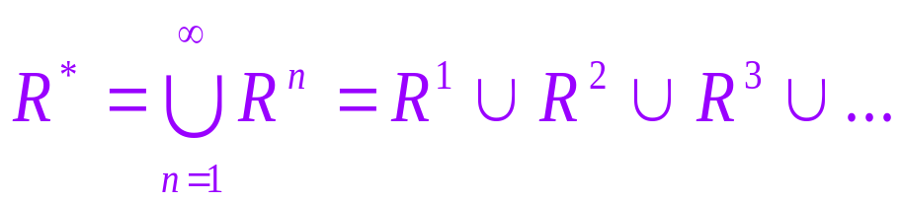
Closures of Relations
According to the train example, the transitive closure of a relation consists of the pairs of vertices in the associated directed graph that are connected by a path.
Definition: Let R be a relation on a set A. The connectivity relation R* consists of the pairs (a, b) such that there is a path between a and b in R.
We know that R^{n} consists of the pairs (a, b) such that a and b are connected by a path of length n.
Therefore, R* is the union of R^{n} across all positive integers n:
Discrete Mathematics : Relations

Slide 54
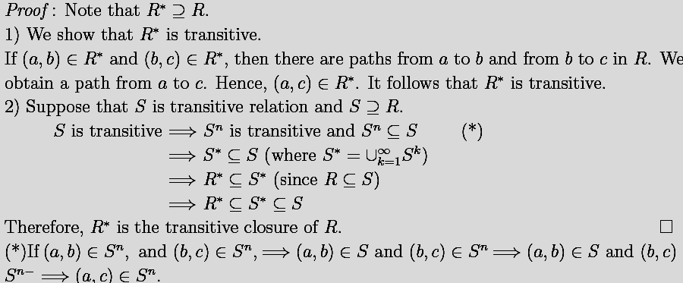
Closures of Relations
Theorem: The transitive closure of a relation R equals the connectivity relation R*.
Discrete Mathematics : Relations

Slide 55
Closures of Relations
But how can we compute R* ?
Lemma: Let A be a set with n elements, and let R be a relation on A. If there is a path in R from a to b, then there is such a path with length not exceeding n.
Moreover, if a ≠ b and there is a path in R from a to b, then there is such a path with length not exceeding (n – 1).
Discrete Mathematics : Relations

Slide 56
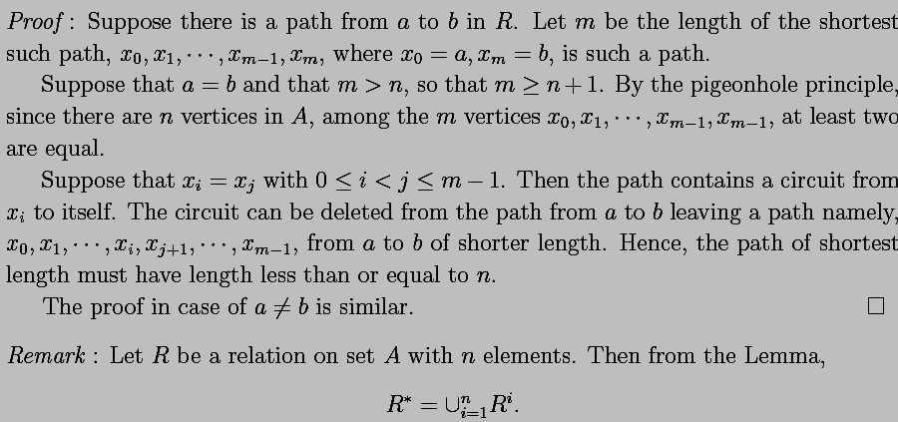
Closures of Relations
Discrete Mathematics : Relations

Slide 57
Closures of Relations
This lemma is based on the observation that if a path from a to b visits any vertex more than once, it must include at least one circuit.
These circuits can be eliminated from the path, and the reduced path will still connect a and b.
Theorem: For a relation R on a set A with n elements, the transitive closure R* is given by:
R* = R∪R²∪R³∪…∪R^{n}
For matrices representing relations we have:
M_{R*} = M_{R}∨M_{R}^{[2]}∨M_{R}^{[3]}∨…∨M_{R}^{[n]}
Discrete Mathematics : Relations

Slide 58
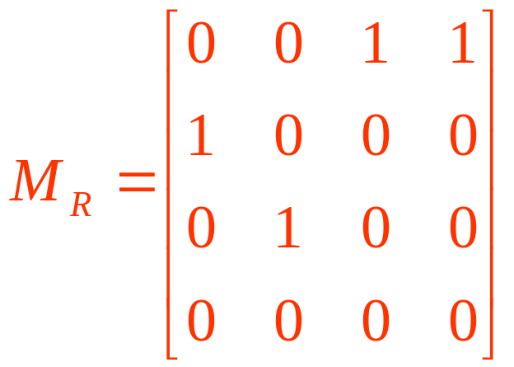
Closures of Relations
Let us finally solve Example III by finding the transitive closure of the relation R = {(1, 3), (1, 4), (2, 1), (3, 2)} on the set A = {1, 2, 3, 4}.
R can be represented by the following matrix M_{R}:
Discrete Mathematics : Relations

Slide 59
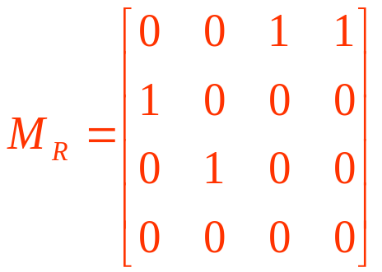
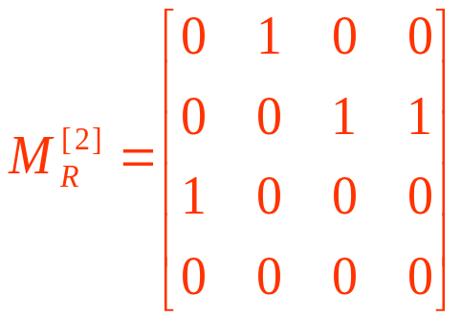
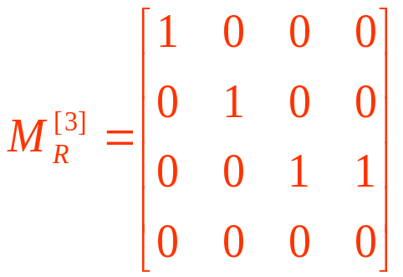
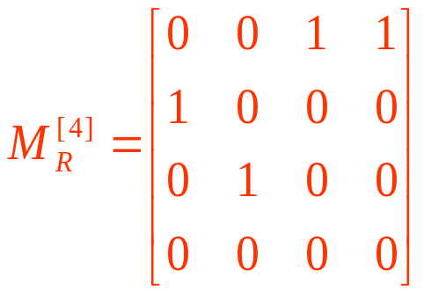
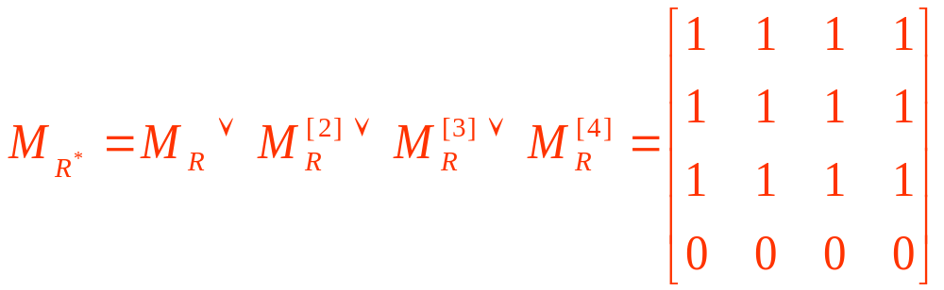
Closures of Relations
Discrete Mathematics : Relations

Slide 60
Closures of Relations
Solution: The transitive closure of the relation R = {(1, 3), (1, 4), (2, 1), (3, 2)} on the set A = {1, 2, 3, 4} is given by the relation
{(1, 1), (1, 2), (1, 3), (1, 4), (2, 1), (2, 2), (2, 3), (2, 4),
(3, 1), (3, 2), (3, 3), (3, 4)}
Discrete Mathematics : Relations

Slide 61
Example. Let R be a relation on a set A, where
A={1,2,3,4,5}, R={(1,2),(2,3),(3,4),(4,5)}.
What is the transitive closure R_{t} of R ?
Sol :
∴R_{t} = (1,2),(2,3),(3,4),(4,5)
(1,3),(1,4),(1,5)
(2,4),(2,5)
(3,5)
1
3
5
2
4
Discrete Mathematics : Relations
7.4.5

Slide 62
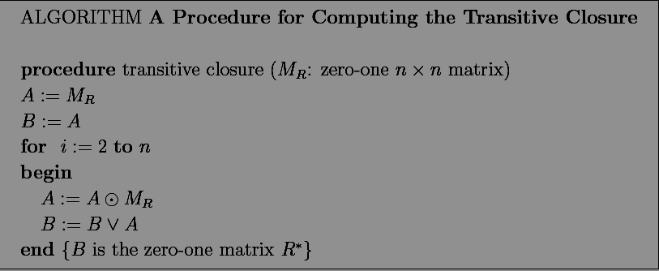
Closures of Relations
Discrete Mathematics : Relations

Slide 63
Closures of Relations
Warshall’s Algorithm
Warshall’s Algorithm, described by StephenWarshall in 1960 uses only 2n³ bit operators.
Suppose that R is a relation on a set with n elements. Let v₁,v₂,…, v_{n} be an arbitrary listing of these n elements.
The interior vertices of a path is used in Warshall’s Algorithm.
Discrete Mathematics : Relations

Slide 64


Closures of Relations
—If a,x₁, x₂,…, x_{n-1,} b is a path, its interior vertices are x₁, x₂,…, x_{n-1}, that is, all vertices of the path that occur somewhere other than the first and the last vertices in the path.
Warshall’s Algorithm is based on the construction of a sequence of zero-one matrices
W₀,W_{1,…,}W_{n}, where W₀ = M_{R} and
Discrete Mathematics : Relations

Slide 65
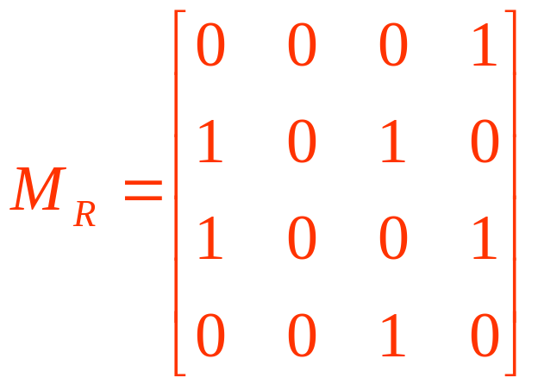
Closures of Relations
Then W_{n} = M_{R*} . Since the (i,j )th entry of M_{R*} is 1 if and only if there is a path from v_{i} to v_{j} , with all interior vertices in set v₁, v₂,…, v_{n}.
Example Let
to represent a relation on set A. Let a, b, c, d be a listing of elements of set A.Find the matrixes W₀,W₁,W₂,W₃,W₄, W₄ is the transitive closure of R.
Discrete Mathematics : Relations

Slide 66
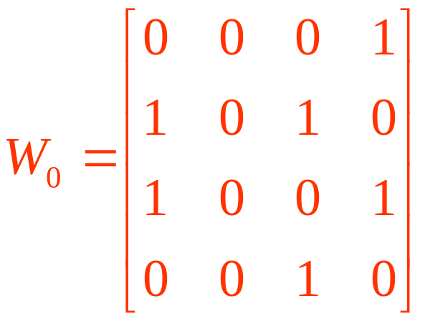
Closures of Relations
Solution : Let v₁ = a, v₂ = b, v₃ = c, and v₄ = d. Hence,
W₁ has 1 as its (I,j)th entry if there is a path from v_{i} to v_{j} that only has only v₁=a as an interior vertex. Then
Discrete Mathematics : Relations

Slide 67

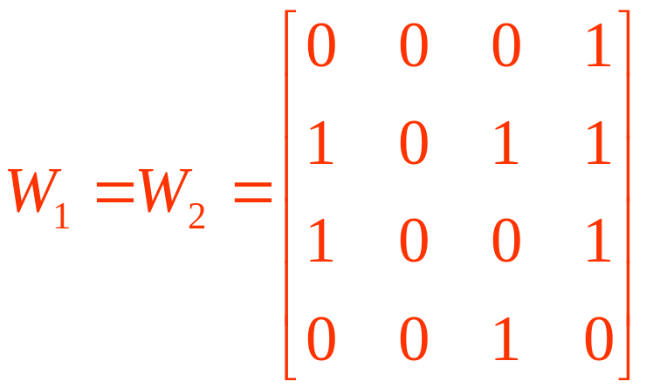
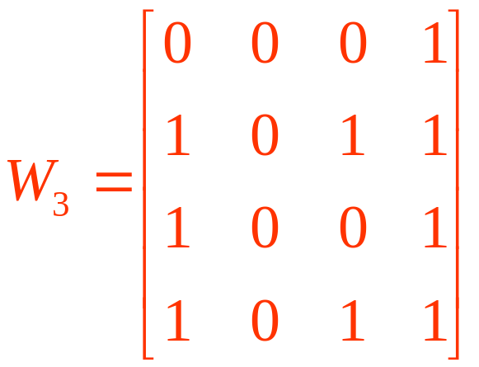
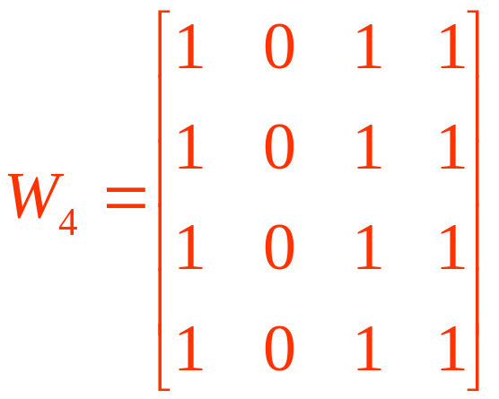
Closures of Relations
Discrete Mathematics : Relations

Slide 68
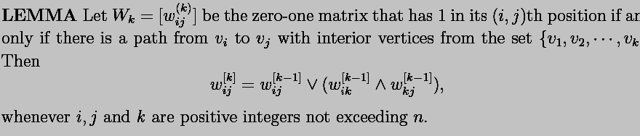
Closures of Relations
Discrete Mathematics : Relations

Slide 69
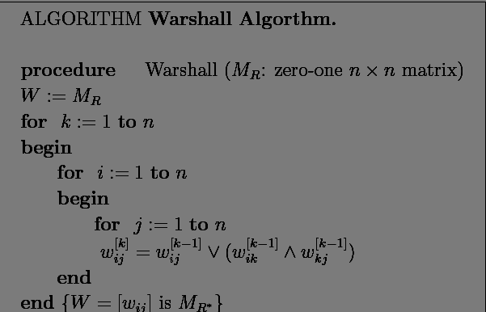
Closures of Relations
Discrete Mathematics : Relations

Slide 70
Equivalence Relations
Equivalence relations are used to relate objects that are similar in some way.
Definition: A relation on a set A is called an equivalence relation if it is reflexive, symmetric, and transitive.
Two elements that are related by an equivalence relation R are called equivalent.
Discrete Mathematics : Relations

Slide 71
Equivalence Relations
Since R is symmetric, a is equivalent to b whenever b is equivalent to a.
Since R is reflexive, every element is equivalent to itself.
Since R is transitive, if a and b are equivalent and b and c are equivalent, then a and c are equivalent.
Obviously, these three properties are necessary for a reasonable definition of equivalence.
Discrete Mathematics : Relations

Slide 72
Equivalence Relations
Example: Suppose that R is the relation on the set of strings that consist of English letters such that aRb if and only if l(a) = l(b), where l(x) is the length of the string x. Is R an equivalence relation?
Solution:
R is reflexive, because l(a) = l(a) and therefore
aRa for any string a.
R is symmetric, because if l(a) = l(b) then l(b) =
l(a), so if aRb then bRa.
R is transitive, because if l(a) = l(b) and l(b) = l(c),
then l(a) = l(c), so aRb and bRc implies aRc.
R is an equivalence relation.
Discrete Mathematics : Relations

Slide 73
Equivalence Classes
Definition: Let R be an equivalence relation on a set A. The set of all elements that are related to an element a of A is called the equivalence class
of a.
The equivalence class of a with respect to R is denoted by [a]_{R}.
When only one relation is under consideration, we will delete the subscript R and write [a] for this equivalence class.
If b∈[a]_{R}, b is called a representative of this equivalence class.
Discrete Mathematics : Relations

Slide 74
Equivalence Classes
Example: In the previous example (strings of identical length), what is the equivalence class of the word mouse, denoted by [mouse] ?
Solution: [mouse] is the set of all English words containing five letters.
For example, ‘horse’ would be a representative of this equivalence class.
Discrete Mathematics : Relations

Slide 75
Equivalence Classes
Theorem: Let R be an equivalence relation on a set A. The following statements are equivalent:
aRb
[a] = [b]
[a] ∩ [b] ≠ ∅
Definition: The set of all equivalence classes of R is the quotient set of A with respect to R.
A/R = {[a]_{R} | a ∈ A}
Remark :
1) If A finite, then A/R finite.
2) If A has n elements, and if every [a]_{R} has m elements, then m/n, and A/R has n/m elements.
Discrete Mathematics : Relations

Slide 76
Equivalence Classes
Definition: A partition of a set S is a collection of disjoint nonempty subsets of S that have S as their union. In other words, the collection of subsets A_{i}, i∈I, forms a partition of S if and only if
(i) A_{i} ≠ ∅ for i∈I
A_{i} ∩ A_{j} = ∅, if i ≠ j
∪_{i∈I} A_{i} = S
Discrete Mathematics : Relations

Slide 77
Equivalence Classes
Examples: Let S be the set {u, m, b, r, o, c, k, s}.
Do the following collections of sets partition S ?
{{m, o, c, k}, {r, u, b, s}}
yes.
{{c, o, m, b}, {u, s}, {r}}
no (k is missing).
{{b, r, o, c, k}, {m, u, s, t}}
no (t is not in S).
{{u, m, b, r, o, c, k, s}}
yes.
{{b, o, o, k}, {r, u, m}, {c, s}}
yes ({b,o,o,k} = {b,o,k}).
{{u, m, b}, {r, o, c, k, s}, }
no ( not allowed).
Discrete Mathematics : Relations

Slide 78
Equivalence Classes
Theorem: Let R be an equivalence relation on a
set S. Then the equivalence classes of R form a partition of S. Conversely, given a partition
{A_{i} | i∈I} of the set S, there is an equivalence relation R that has the sets A_{i}, i∈I, as its equivalence classes.
Proof: Let S ={A₁,A₂,…,A_{n}} be a partition of S
Define a relation R on S by xRy if x, y are in the same set A_{i} i.e.
Then, R is an equivalence relation on S.
Discrete Mathematics : Relations

Slide 79
Equivalence Classes
Example: Let us assume that Frank, Suzanne and George live in Boston, Stephanie and Max live in Lübeck, and Jennifer lives in Sydney.
Let R be the equivalence relation {(a, b) | a and b live in the same city} on the set P = {Frank, Suzanne, George, Stephanie, Max, Jennifer}.
Then R = {(Frank, Frank), (Frank, Suzanne),
(Frank, George), (Suzanne, Frank), (Suzanne, Suzanne), (Suzanne, George), (George, Frank),
(George, Suzanne), (George, George), (Stephanie,
Stephanie), (Stephanie, Max), (Max, Stephanie),
(Max, Max), (Jennifer, Jennifer)}.
Discrete Mathematics : Relations

Slide 80
Equivalence Classes
Then the equivalence classes of R are:
{{Frank, Suzanne, George}, {Stephanie, Max}, {Jennifer}}.
This is a partition of P.
The equivalence classes of any equivalence relation R defined on a set S constitute a partition of S, because every element in S is assigned to exactly one of the equivalence classes.
Discrete Mathematics : Relations

Slide 81
Equivalence Classes
Another example: Let R be the relation
{(a, b) | a ≡ b (mod 3)} on the set of integers.
Is R an equivalence relation?
Yes, R is reflexive, symmetric, and transitive.
What are the equivalence classes of R ?
{{…, -6, -3, 0, 3, 6, …},
{…, -5, -2, 1, 4, 7, …},
{…, -4, -1, 2, 5, 8, …}}
Discrete Mathematics : Relations

Slide 82
Equivalence Classes
Another example:A={1,2,3}，find all the equivalence relation on A.
Discrete Mathematics : Relations

Slide 83
Partial Orderings
Sometimes, relations do not specify the equality of elements in a set, but define an order on them.
Definition: A relation R on a set S is called a partial ordering or partial order if it is reflexive, antisymmetric, and transitive.
A set S together with a partial ordering R is called a partially ordered set, or poset, and is denoted by (S, R).
Discrete Mathematics : Relations

Slide 84
Partial Orderings
Example: Consider the “greater than or equal” relation ≥ (defined by {(a, b) | a ≥ b}).
Is ≥ a partial ordering on the set of integers?
≥ is reflexive, because a ≥ a for every integer a.
≥ is antisymmetric, because if a ≠ b, then
a ≥ b ∧ b ≥ a is false.
≥ is transitive, because if a ≥ b and b ≥ c, then
a ≥ c.
Consequently, (Z, ≥) is a partially ordered set.
Discrete Mathematics : Relations

Slide 85
Partial Orderings
Another example: Is the “inclusion relation” ⊆
a partial ordering on the power set of a set S?
⊆ is reflexive, because A ⊆ A for every set A.
⊆ is antisymmetric, because if A ≠ B, then
A ⊆ B ∧ B ⊆ A is false.
⊆ is transitive, because if A ⊆ B and B ⊆ C, then
A ⊆ C.
Consequently, (P(S), ⊆) is a partially ordered set.
Discrete Mathematics : Relations

Slide 86
Partial Orderings
In a poset the notation a ≤ b denotes that (a, b)∈R.
Note that the symbol ≤ is used to denote the relation in any poset, not just the “less than or equal” relation.
The notation a < b denotes that a ≤ b, but a ≠ b.
If a < b we say “a is less than b” or “b is greater than a”.
Discrete Mathematics : Relations

Slide 87
Partial Orderings
For two elements a and b of a poset (S, ≤) it is possible that neither a ≤ b nor b ≤ a.
Example: In (P(Z), ⊆), {1, 2} is not related to {1, 3}, and vice versa, since neither is contained within
the other.
Definition: The elements a and b of a poset (S, ≤) are called comparable if either a ≤ b or b ≤ a.
When a and b are elements of S such that neither
a ≤ b nor b ≤ a, then a and b are called incomparable.
Discrete Mathematics : Relations

Slide 88
Partial Orderings
For some applications, we require all elements of a set to be comparable.
For example, if we want to write a dictionary, we need to define an order on all English words (alphabetic order).
Definition: If (S, ≤) is a poset and every two elements of S are comparable, S is called a totally ordered or linearly ordered set, and ≤ is called a total order or linear order. A totally ordered set is also called a chain.
Discrete Mathematics : Relations

Slide 89
Partial Orderings
Example I: Is (Z, ≤) a totally ordered poset?
Yes, because a ≤ b or b ≤ a for all integers a and b.
Example II: Is (Z⁺, |) a totally ordered poset?
No, because it contains incomparable elements such as 5 and 7.
Example III: Is (P(S), ⊆) a totally ordered poset?
No, because it contains incomparable elements such as {1,2} and {1,3}.
Discrete Mathematics : Relations

Slide 90
Lexicographic Order
Construct a partial ordering on the Cartesian product of two posets (A_{1,} ≤₁) and (A_{2,} ≤₂) .
The lexicographic ordering ≤ on A₁×A₂ is defined by:
(a₁, a₂) is less than (b₁, b₂), that is,
(a₁, a₂) < (b₁, b₂)
either if a₁ <₁ b₁ or if both a₁ = b₁ and a₁ <₂ b₂.
Discrete Mathematics : Relations

Slide 91
Lexicographic Order
A lexicographic ordering can be defined on the Cartesian product of n posets (A_{1,} ≤₁),(A_{2,} ≤₂),…, (A_{n ,} ≤_{n}).is defined by:
(a₁, a_{2,},…,a_{n}) is less than (b₁, b₂,…,b_{n}), that is, (a₁, a_{2,},…,a_{n}) < (b₁, b₂,…,b_{n})
either if a₁ <₁ b₁ or if there is an integer i>0 such that a₁ = b₁ ,…,a_{i}=b_{i} and a_{i+1} <_{I+1} b_{i+1.}
Discrete Mathematics : Relations

Slide 92
Hasse Diagram
In general, we can represent a partial ordering on a finite set using the following procedure:
1) Start with the directed graph for the relation.
2) Remove all loops( a partial ordering is reflexive, a loop is present at every vertex);
3) Remove all edges that must be present because of the transitivity;
4) Finally, arrange each edges so that its initial vertex is below its terminal vertex,remove all the arrows on the directed edges.
Discrete Mathematics : Relations

Slide 93
Hasse Diagram
Example 1 Draw the Hasse diagram representing the partial ordering {(a, b)|a divides b} on the set {1, 2, 3, 5, 6, 10, 15,30}.
Example 2 Draw the Hasse diagram for the partial ordering {(A,B)|A ⊆ B} on the power set 2^{S}, where S = {a, b, c}.
Discrete Mathematics : Relations

Slide 94
Maximal and Minimal Elements
¤ （A, ≤ ）—— be a partial ordered set, B⊆A
1) a ∈ B is a maximal element of B --- There is no x ∈ B such that a <x.
b ∈ B is a minimal element of B --- There is no x ∈ B such that x < b.
2) a ∈B is the greatest element of B --- ∀ x ∈ B : (x ≤ a).
b ∈ B is the least element of B --- ∀ x ∈ B : (b ≤ x).
3) c ∈ A is an upper bound of B--- ∀ x ∈ B : x ≤ c.
d ∈ A is an lower bound of B --- ∀ x ∈ B : d ≤ x.
4) c ∈ A is an least upper bound of B:c is a upper bound of B and ∀ x is a upper bound of B =) c ≤ x.
d ∈ A is an greatest lower bound of B:d is a lower bound of B and ∀ x is a lower bound of B =) x ≤ d.
Discrete Mathematics : Relations

Slide 95
Maximal and Minimal Elements
Example
(2^{S}, ⊆) where S = {a, b, c}, and B ={∅, {a}, {c}, {a, b}}.
(1) minimal element ∅;
(2) maximal element {c}; {a, b}
(3) the greatest element. no greatest
(4) the least element ∅;
(5) upper bound {a, b, c}
(6) least upper bound {a, b, c}
(7) lower bound ∅;
(8) the greatest lower bound ∅;
Discrete Mathematics : Relations

Slide 96
Well-ordered set
¤ (S, ≤ ) is a well-ordered set if it is a poset such that ≤ is a total ordering and such that every nonempty subset of S has a least element.
Example (Z, ≤ ) is not well-ordered since the set of negative integers has no least element.
Discrete Mathematics : Relations

Slide 97
Lattice
A partially ordered set in which pair of elements has both a least upper bound and a greatest lower bound is called lattice.
Example 1) Is the poset (Z, /) a lattice?
2) Is the poset ({1, 2, 3, 4, 5}, /) a lattice?
3) Determine whether (2^{S}, ⊆) is a lattice where S = {a, b, c}.
Discrete Mathematics : Relations

